Slide 1
EMERGENCE OF BANGLADESH
THE WAR OF INDEPENDENCE

Slide 2
OUTLINE
Learning Objectives:
Recognize that the war of independence was the culmination of decades of struggle for social, economic, cultural, political emancipation of the people of Bangladesh
Trace the events from the 1969 mass uprising to the start of the genocide by Pakistan on March 26th 1971
Identify the critical leaders in Bangladesh and their contributions during the war of independence
Identify the war criminals and their role in the genocide and the killing of Bengalee intellectuals
Describe the role of superpowers and the global support for Bangladesh in the war of independence

Slide 3
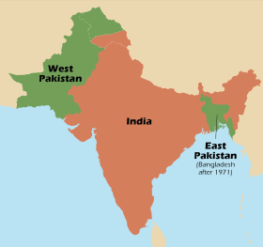
FROM OPPRESSION TO EMANCIPATION
Movement against the denial of Bengali language and culture
Movement against economic exploitation, regional disparity, income inequality & impoverishment of rural peasantry
Movement against discrimination in administration, justice & national security
Movement against oppression of the military bureaucratic state

Slide 4
PROVINCIAL ELECTION OF 1954
First election in East Pakistan: universal adult franchise
United Front contested against the Muslim League on 21-point demand
recognition of Bengali as one of the state languages
introduce free and universal primary education
abolish zamindari system and distribute land to peasants
economic and social rights of industrial workers
nationalization of the jute industry
protect country from flood and famine
army HQ in WP, navy HQ in EP, ordnance factory in EP
Landslide victory of United Front: 228 seats out of 309, Muslim League won only 7 seats

Slide 5
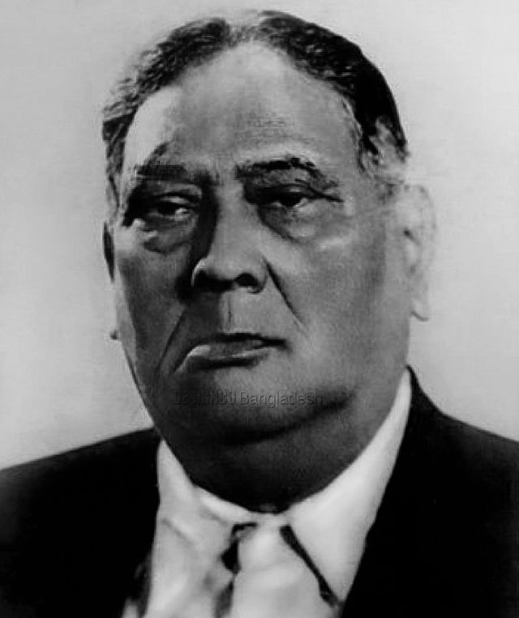
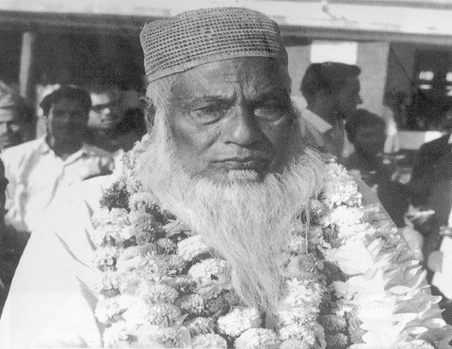
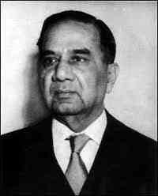
LEADERS OF THE UNITED FRONT
A K Fazlul Huq
Huseyn Shaheed Suhrawardy
Maulana Abdul Hamid Khan Bhasani
The Jukto Front government was dismissed by Governor-General Ghulam Muhammad in a few months

Slide 6
CONSTITUTIONAL COUPS IN PAKISTAN
1953: Governor General Ghulam Muhammad dismisses Prime Minister Khawaja Nazimuddin for failure to control EP autonomy demands & imposes direct rule over EP
October 1954: Ghulam Muhammad dissolves First Constituent Assembly
July 1955: Second Constituent Assemble convened
August 1955: Chaudhry Muhammad Ali becomes PM
September 1955: General Iskander Mirza becomes Governor General
March 1956: Constitution for Islamic Republic of Pakistan adopted
September 1956: Suhrawardy becomes PM of Pakistan
October 1957: Suhrawardy removed as PM
October 7, 1958: Iskander Mirza imposes Martial Law
October 27, 1958: General Ayub Khan removes Iskander Mirza
March 1962: Ayub Khan introduces new constitution

Slide 7
CONSTITUTION OF 1956
Second Constituent Assembly drafted and ratified the first constitution of Pakistan
Islamic republic
Parliamentary form of government
National parliament of 300 members, equally representing East and West Pakistan
Bengali recognized as one of the state languages
West Pakistan was integrated into one unit

Slide 8
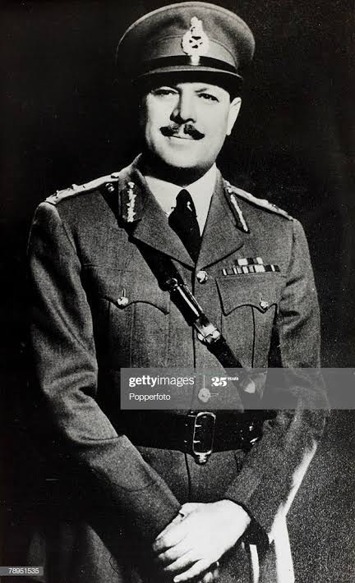
MILITARY DICTATORSHIP: OCTOBER 1958
FIELD MARSHAL (SELF PROCLAIMED) MOHAMMAD AYUB KHAN

Slide 9
THE AYUB ERA
1958: Martial Law, preemptive action to stop 1959 parliamentary elections and having majority Bengalis form government
1958 to 1962: Ayub ruled through Punjabi-dominated military and a pliant civil bureaucracy
1962: New Constitution with elections under “Basic Democracy”
Basic Democracy: Indirect elections; President and Parliament elected through an Electoral College of 80,000 Basic Democrats
Patronage to Basic Democrats ensured Ayub Khan victory in elections in 1964-65

Slide 10
1962: MOVEMENT AGAINST AYUB’S EDUCATION POLICY
1962: S. M. Sharif Education Commission publishes its report
Urdu should be made the language of the people of Pakistan
English should be made compulsory from fourth grade
No free primary education
Education not to be subsidized
Strong student movement against Sharif Commission Report September 17, 196; 3 killed in police firing.

Slide 11
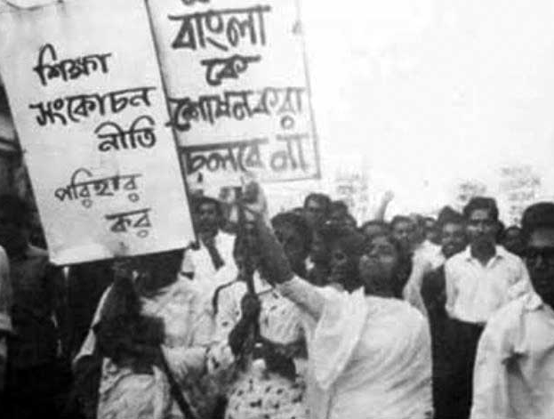
1962: MOVEMENT AGAINST AYUB’S EDUCATION POLICY

Slide 12
THE AYUB ERA (CONT.)
1965: disastrous war with India over Kashmir; East Pakistan left defenseless
Dissatisfaction with continued disparity intensifies Bengali opposition to Pakistan government
1966: Six Point Demand by Sheikh Mujibur Rahman
The intellectual basis of Six Points was the idea of two economies propounded by Bengali economists
1966-1969: Popular protests and mobilization across the country met with severe repression and arrests
1968: Pakistan government frames Agartala Conspiracy Case against Mujib and others with charges of treason

Slide 13
THE AYUB ERA: 6 POINT DEMAND
The Six Point demands were:
Creating provision in the constitution for a Federation of Pakistan in its true sense based on the Lahore resolution
The federal government will deal with only two subjects: Defense and Foreign Affairs
Introduction of two separate, but freely convertible currencies for East and West Pakistan
Vesting the power of taxation and revenue collection with the federating units
Maintaining two separate accounts for the foreign exchange earnings of the two wings and
Creation of a separate militia or paramilitary force for East Pakistan

Slide 14
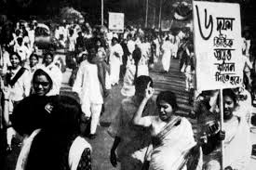
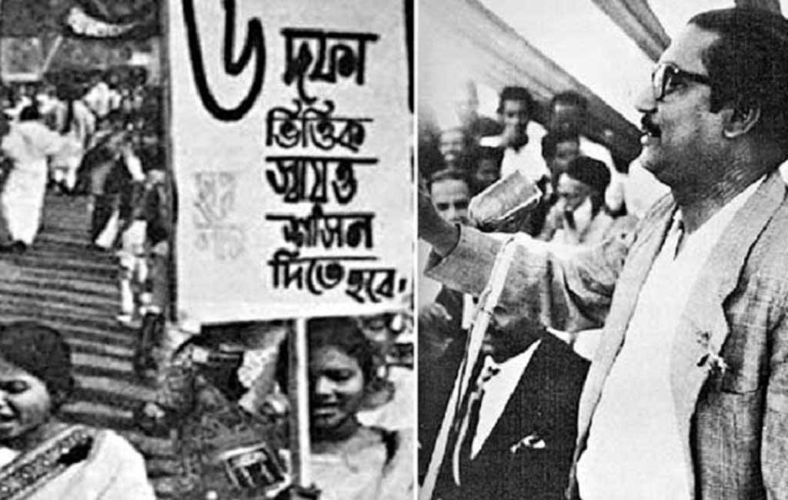
THE AYUB ERA: 6 POINT DEMAND

Slide 15
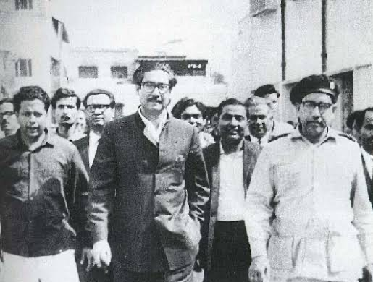
STATE VS. SHEIKH MUJIBUR RAHMAN AND OTHERS

Slide 16
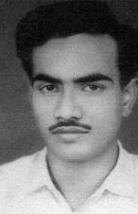
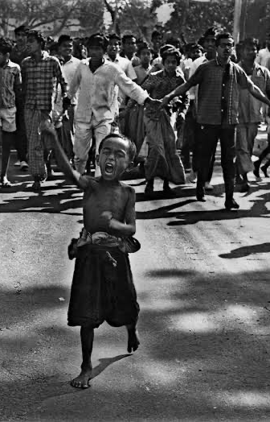
1969: STUDENT LED MASS MOVEMENT

Slide 17

MASS UPSURGE, 1969 AND FALL OF AYUB KHAN
1968 Agartala Conspiracy Case and the arrest of Sheikh Mujibur Rahman fuelled a mass movement in the East
All parties of Pakistan came under one demand for the fall of Ayub Khan
Protest rallies, student agitation and labor strikes increased in intensity
March 25, 1969 Ayub relinquished his presidency

Slide 18
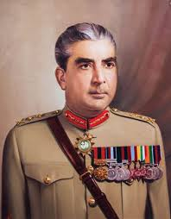
RISE OF ANOTHER MILITARY DICTATOR: GENERAL YAHYA
Ayub Khan handed over power to Army Commander Gen Yahya Khan
Martial law was declared
Chief Martial Law Administrator Gen Yahya Khan on March 31, 1969 declared himself President
Election through universal adult franchise was promised
National Assembly of 300 seats to include 162 from EP and 138 from WP

Slide 19
NOVEMBER 1970: CYCLONE AND ITS IMPACT
On the night between 12 & 13 November, 1970, East Pakistan’s coastline was struck by a major cyclone accompanied by high tidal waves
Over half a million people were killed
The Pakistan state wasn’t even aware; later in denial; and then sent very little relief and way too late
Massive civilian mobilization and foreign relief efforts helped in the recovery
East Pakistan realized through this experience, the insensitivity of the Pakistanis towards them

Slide 20
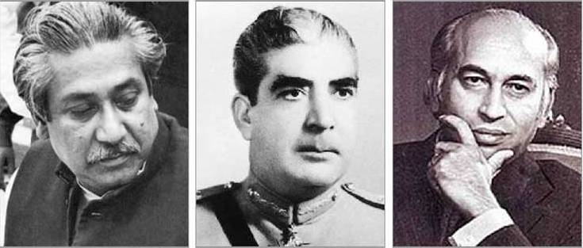
1970 ELECTION AND LANDSLIDE VICTORY
Bangbandhu led Awami League won a landslide victory on the basis of the six point demand
- 160 out of 162 seats in EP ; total seats in Pakistan - 300
Bhutto’s PPP won 81 seats; all in WP
Absolute victory of Awami League energized EP demand for freedom and regional autonomy

Slide 21
POST-ELECTION EVENTS
Bhutto refuses to allow Mujib to form government
January 17, 1971: Yahya visits Bhutto in Larkana with military generals and draws up plan for military action in EP
Pak military in EP strengthened and prepared for Operation Blitz
March 1: Yahya postpones convening of Parliament
Bengalis realize Pakistan cannot be trusted to hand over power
Non Cooperation Movement starts
March 2: Students hoist flag of BD at Dhaka University
March 3: Students read out Manifesto of BD Independence
March 7: Mujib calls on people to resist conspiracies and prepare for struggle for freedom and independence
March: Yahya and Bhutto hold meetings with Mujib and AL but secretly prepare for genocide
March 25: Operation Searchlight and mass killings start under General Khadim Hussain Raja
March 26: Bangabandhu declares independence of Bangladesh

Slide 22
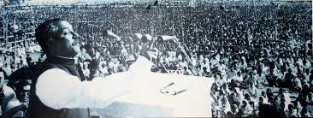
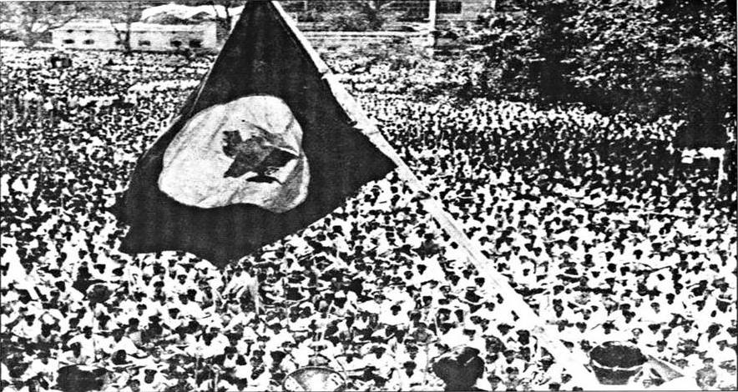
MARCH 2 AND MARCH 7, 1971

Slide 23
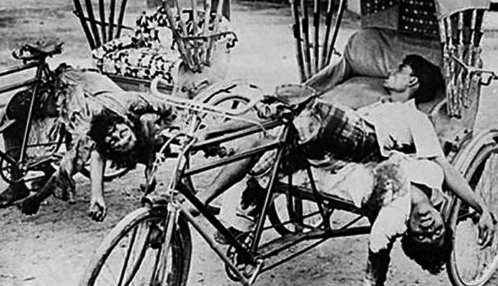
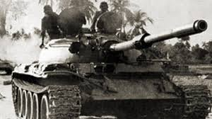
OPERATION SEARCHLIGHT: MILITARY CRACKDOWN
In Dhaka targeted attacks with tanks and artillery on
student halls
university teachers
HQ of Police and East Pakistan Rifles
Hindu residential areas
urban slums

Slide 24
DECLARATION OF INDEPENDENCE
March 26, 1971: Before his arrest, Bangabandhu declared independence of Bangladesh transmitted through EPR wireless
“This may be my last message. From today Bangla Desh is independent. I call upon the people of Bangla Desh, wherever you are and with whatever you have, to resist the army of occupation to the last. Your fight must go on until the last soldier of the Pakistan occupation army is expelled from the soil of Bangla Desh and final victory is achieved.”
March 26, 2:30 PM: AL Leader M A Hannan broadcasts message from Chittagong Radio
March 26 and 27: broadcasts from Kalurghat radio station by Swadhin Bangla Betar Kendra
March 27, 7:30 PM: Major Zia announces independence and military revolt from Kalurghat radio station
Zia’s announcement (on Bangabandhu’s behalf) was heard by many more than earlier announcements and had a strong impact

Slide 25
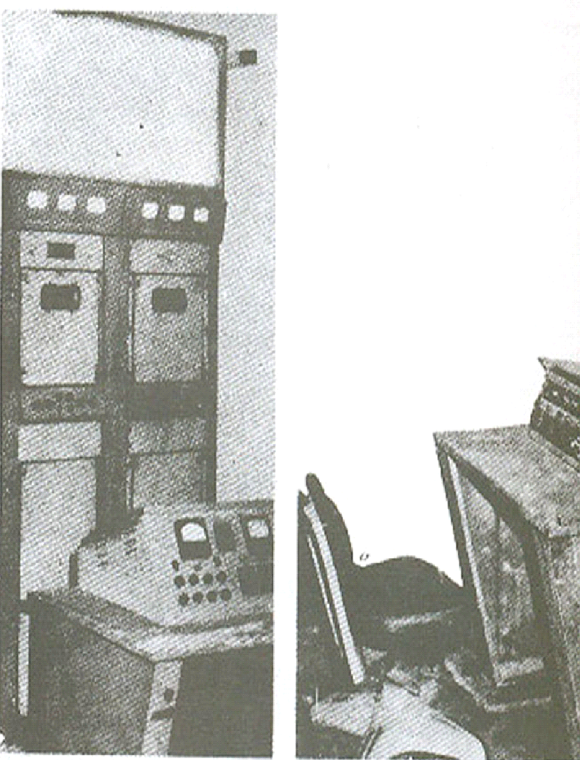
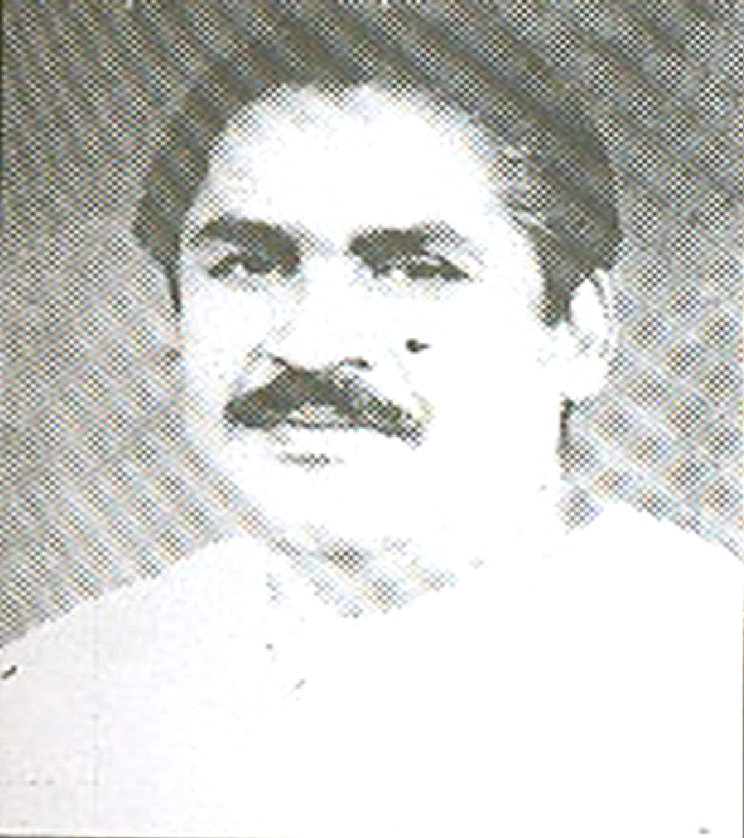
DECLARATION OF INDEPENDENCE
Kalurghat radio transmitter through which Major Zia announced declaration of independence on 27 March and was wiped out by the Pakistan Air Force on March 30.
https://www.youtube.com/watch?v=XtAUbEfi58E
Ziia himself saying he made the radio announcement the evening of March 27th.
M A Hannan in Chittagong played a crucial role in the declaration of independence by Sheikh Mujib on 26 March

Slide 26
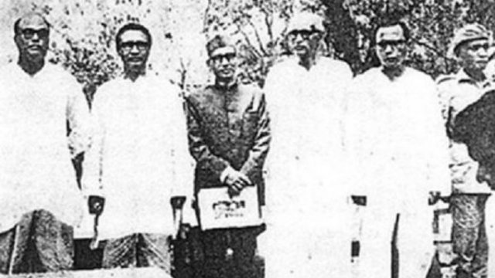
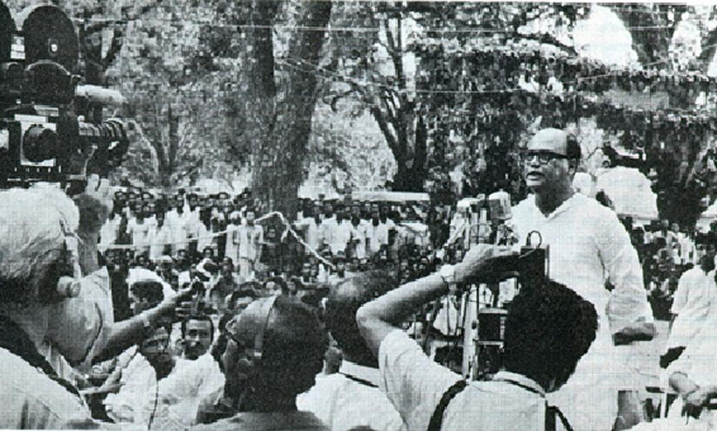
GOVERNMENT-IN-EXILE
Formed on April 10, 1971
Took oath on April 17, 1971 at Mujibnagar, Meherpur, Kushtia
Mujib declared president of BD
Acting President - Syed Nazrul Islam
Prime Minister - Tajuddin Ahmed
Commander of BD Mukti Bahini – Colonel M A G Osmani
A small cabinet was also formed

Slide 27
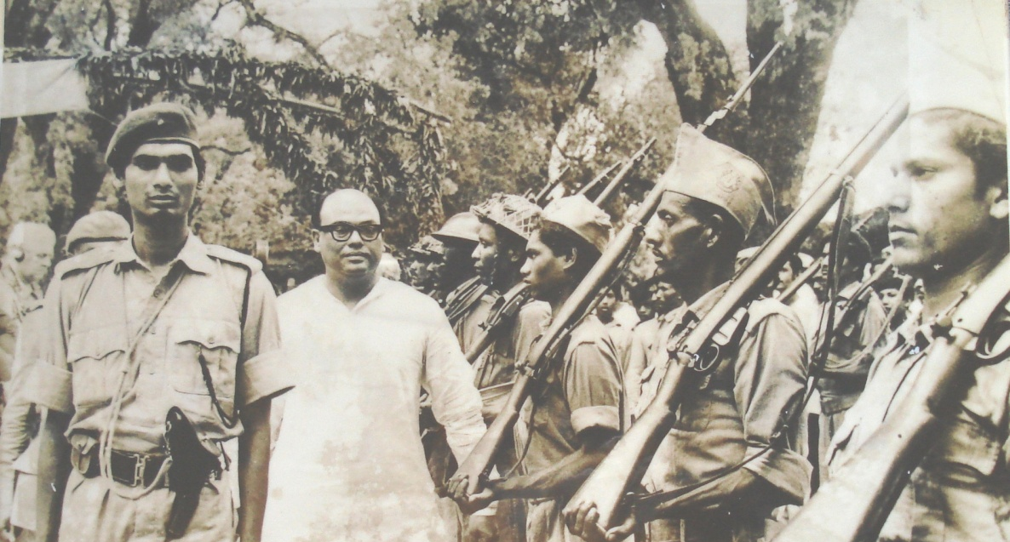
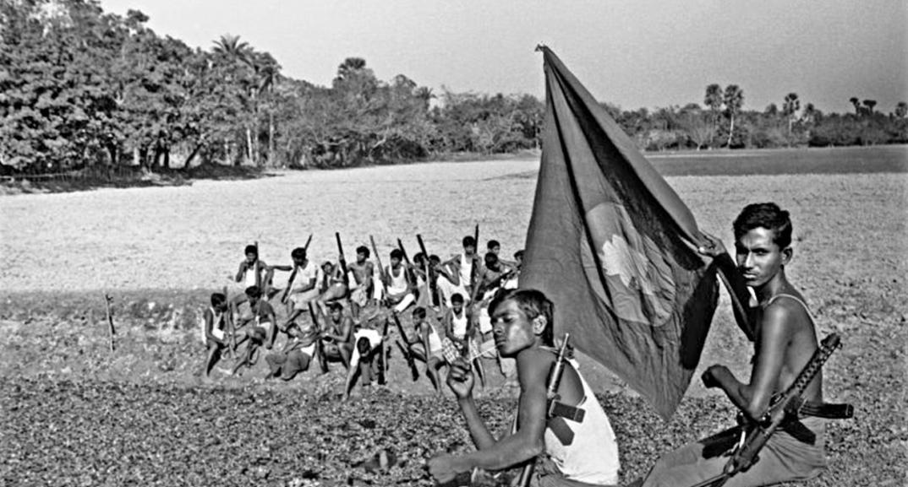
MUKTI BAHINI AND ARMED STRUGGLE
Mukti Bahini also known as freedom fighters
Mujibnagar Government formed Mukti Bahini under the command of Colonel M A G Osmani
War strategy mainly was guerilla warfare
Regular and irregular forces were formed
The country was divided into eleven sectors

Slide 28
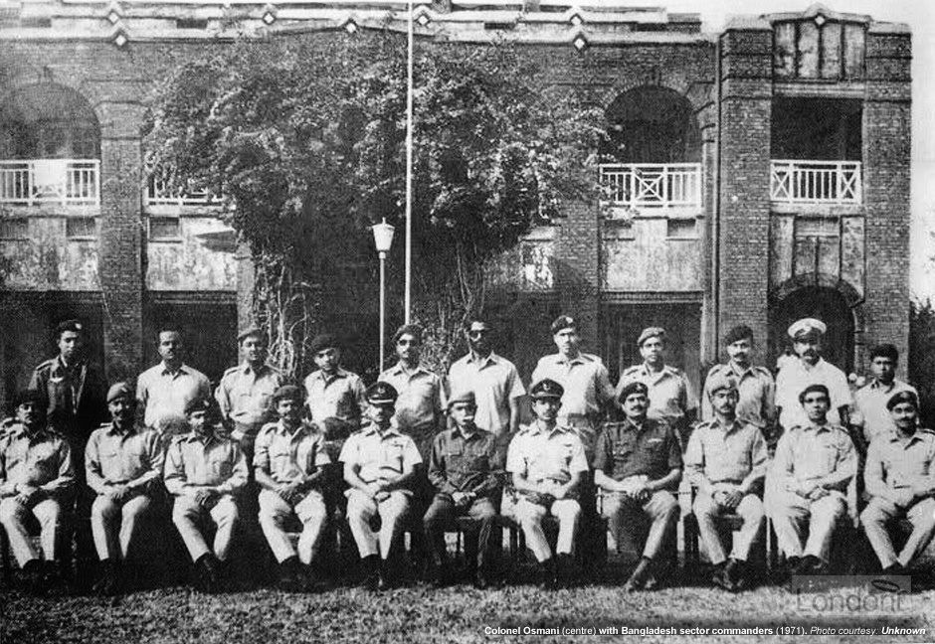
MUKTI BAHINI AND ARMED STRUGGLE (CONT.)
Eleven Sector Commanders

Slide 29
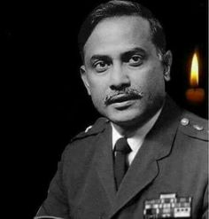
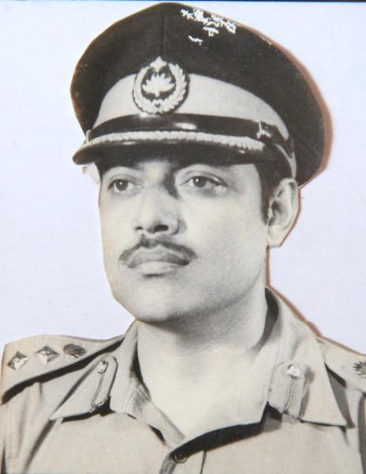
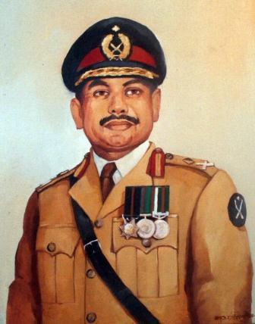
OTHER FORCES
Z Force
Ziaur Rahman
K Force
Khaled Mosharraf
S Force
K.M. Safiullah

Slide 30
OTHER FORCES (CONT.)
Other forces:
Mujib Bahini
Kader Bahini
Some other leftist forces
Brigade forces:
Z force- Ziaur Rahman
K force- Khaled Mosharraf
S force- K.M. Saffiullah
Naval and air wings
Crack platoon of Mukti Bahini was very active in occupied Dhaka and kept people’s morale high

Slide 31
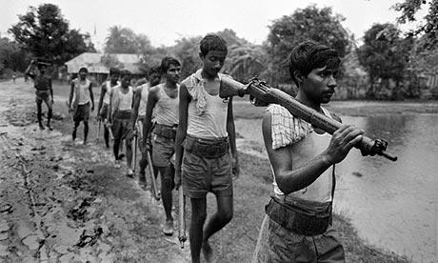
MUKTI BAHINI

Slide 32
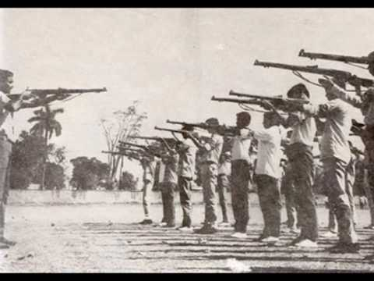
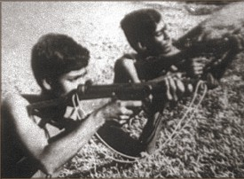
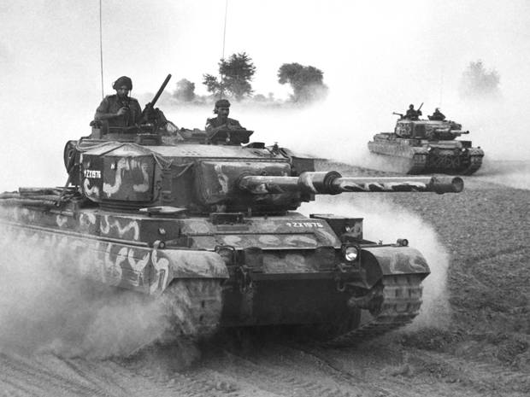
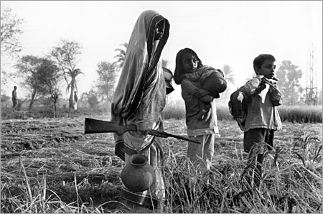
MUKTI BAHINI (CONT.)

Slide 33
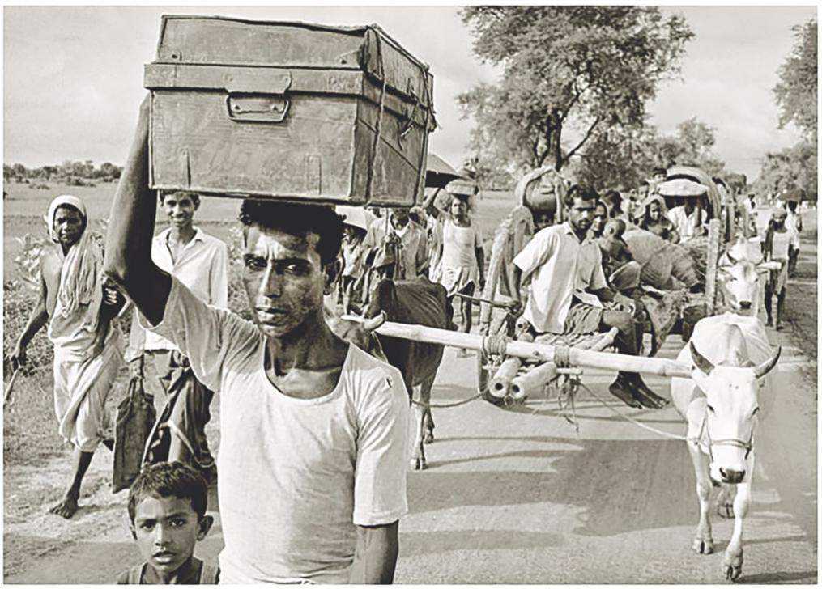
REFUGEES
10 million Bangladeshis fled to India as refugees

Slide 34
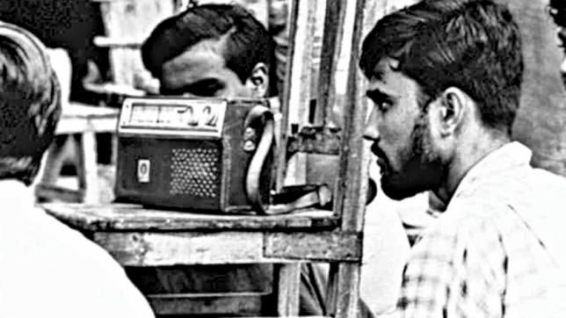
WAR ON THE CULTURAL FRONT
Shadhin Bangla Betar Kendro inspired the people through news and commentary on the war and the heroism of the Mukti Bahini and cultural programs to keep morale high

Slide 35
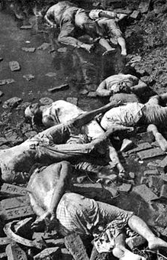
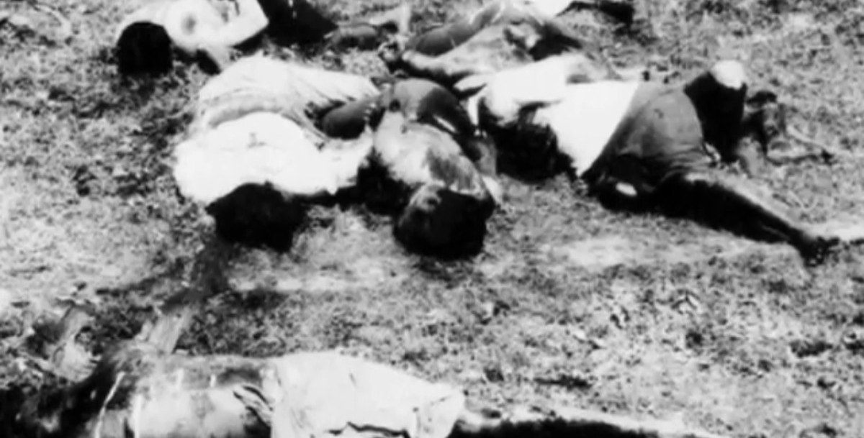
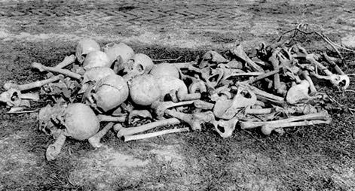
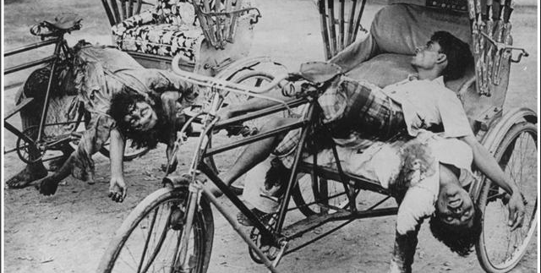
WAR CRIMES IN 1971

Slide 36
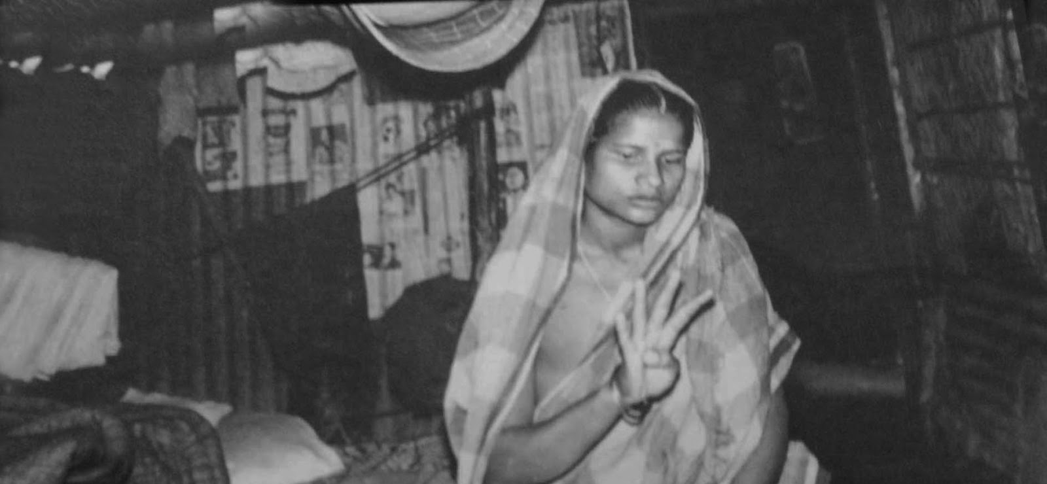
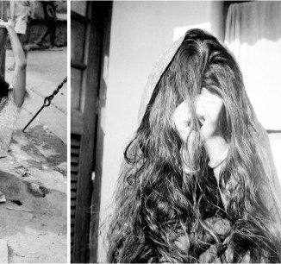

WAR CRIMES IN 1971 (CONT.)
BIRANGANAS

Slide 37
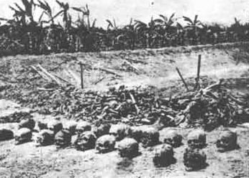
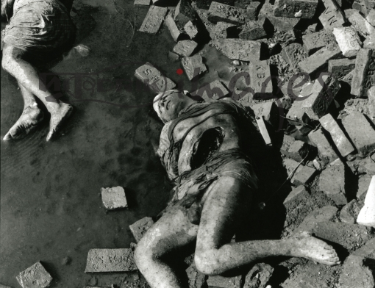
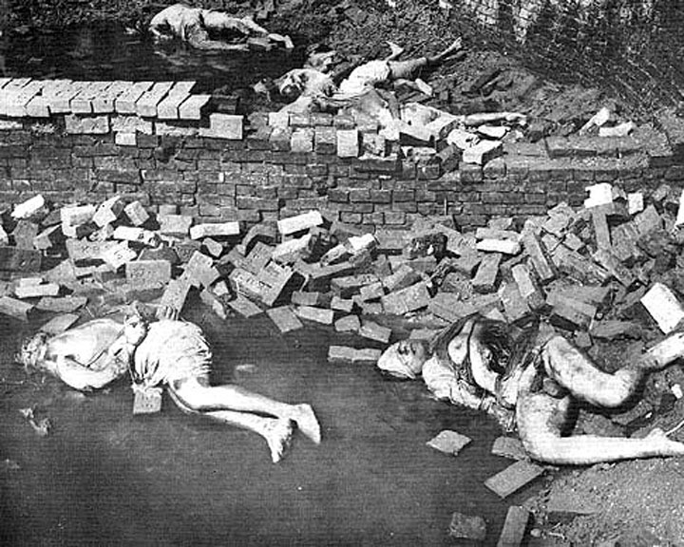
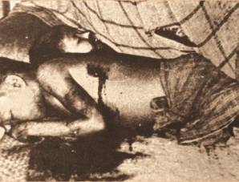
WAR CRIMES
IN 1971
(CONT.)

Slide 38
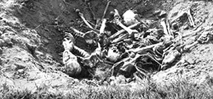
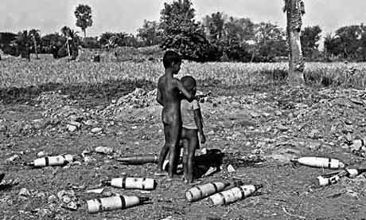
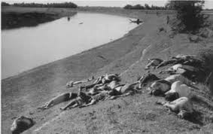
WAR CRIMES IN 1971 (CONT.)

Slide 39
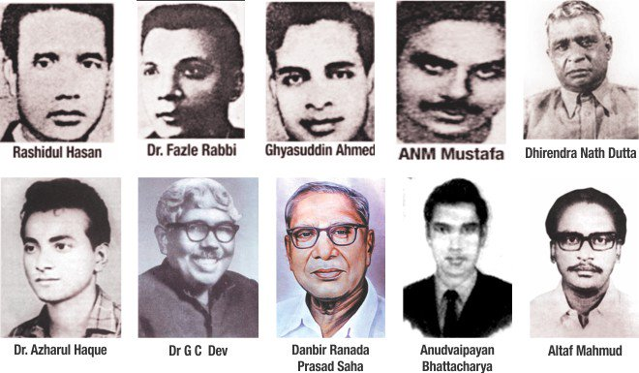
KILLING OF INTELLECTUALS
INTELLECTUAL MARTYRs DAY: 14TH DECEMBER

Slide 40
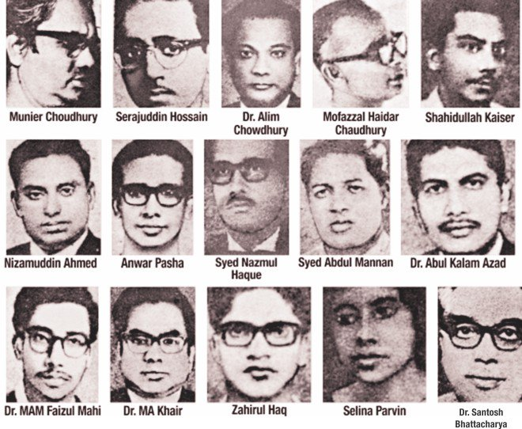
KILLING OF INTELLECTUALS (CONT.)

Slide 41
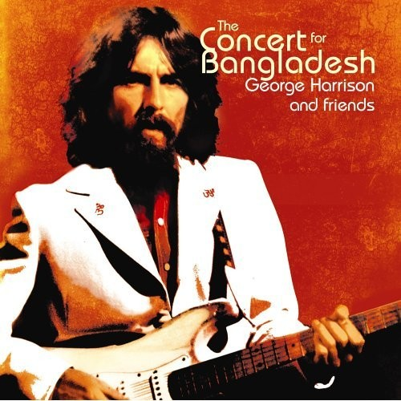


GLOBAL SUPPORT FOR BANGLADESH
Local media couldn’t cover the liberation war stories and Pakistani atrocities
International media wholeheartedly stood beside the oppressed people of Bangladesh
Concert for Bangladesh was organized and drew huge global attention

Slide 42


ROLE OF GLOBAL SUPERPOWERS
Cold War impacted on the liberation war and its outcomes
Role of USA
Role of Soviet Russia
Role of China
Indo-Soviet Friendship Treaty
United Nations Security Council events

Slide 43


THE 14 DAY INDO-PAK WAR: DECEMBER 3-16
Yahya Khan instructed the army to attack on western part of India. But it failed to distract India from East Pakistan.
As a result, India-Pakistan war broke out.
In December, Pakistani soldiers were already in total disaster caused by the Mukti Bahini attacks.
Mukti Bahini gave all information about the ground and the strategic enemy lines.
India launched cross border operation on December 4, 1971 to expel Pakistani army from East Pakistan
Thousands of Indian troops with support of navy and air force set their foots on Bangladeshi soil

Slide 44


SURRENDER OF THE PAKISTANI FORCES
Lieutenant General Niazi signing the
Instrument of Surrender
Lieutenant General Niazi being escorted by Lieutenant General Aurora and Major ATM Haider for the signing of the Instrument of Surrender on 16 December 1971.

Slide 45


LIBERATION DAY
December 16, 1971 is the victory day of Bangladesh
A new country was born based on Bengalee nationalism
Jubilant crowds celebrate the great victory against the powerful Pakistan military forces

Slide 46

SEVEN BIRSRESHTHO

Slide 47

WE ARE BANGLADESH!

